Slide 1


Data Analysis with Power BI
Notes:
Olcu 54

Slide 2





Introduction to Power BI
Lecture 1: Summary
Power BI components
Getting Data from multiple sources
Data Preparation
Add Columns
Merge and Append
Group by
Data Modelling
Creating Relationship between tables
Cardinality
Cross filter options
www.dsa.az Bütün hüquqlar qorunur.
DATA SCIENCE ACADEMY
2

Slide 3


I
Introduction to POWER BI

Slide 4
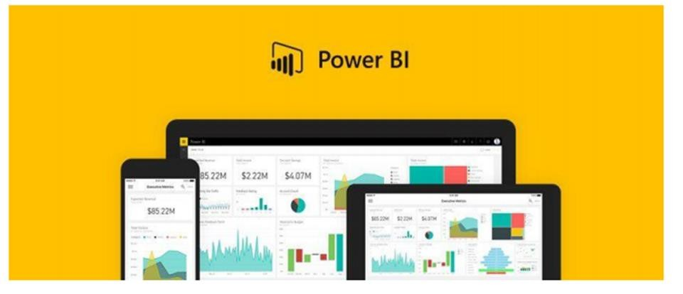
Introduction to Power BI
Interactive reports or
dashboards
Share works by publishing
them in the Power BI Service
Data Models
www.dsa.az Bütün hüquqlar qorunur.
DATA SCIENCE ACADEMY
4

Slide 5
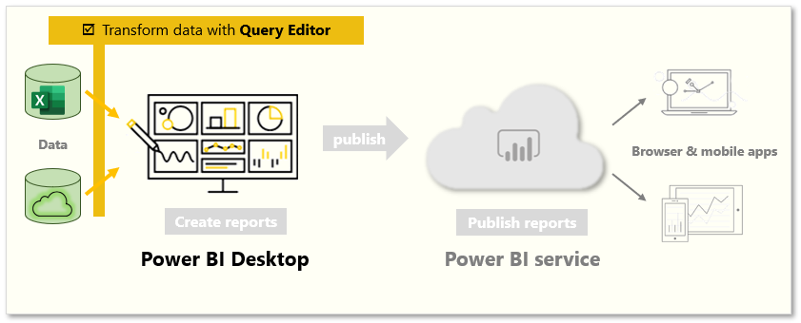

Power BI Components
www.dsa.az Bütün hüquqlar qorunur.
DATA SCIENCE ACADEMY
5

Slide 6

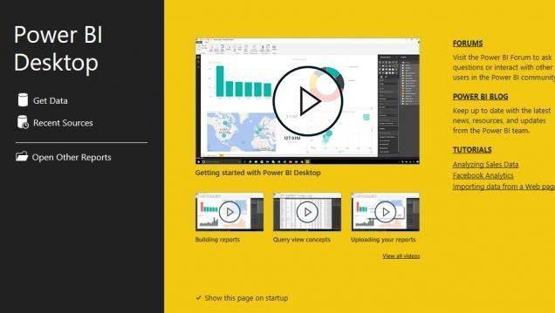

Power BI Desktop
Supports Advanced
Data services
Spectacular visual
graphs
Balanced simplicity and performance
www.dsa.az Bütün hüquqlar qorunur.
DATA SCIENCE ACADEMY
6

Slide 7

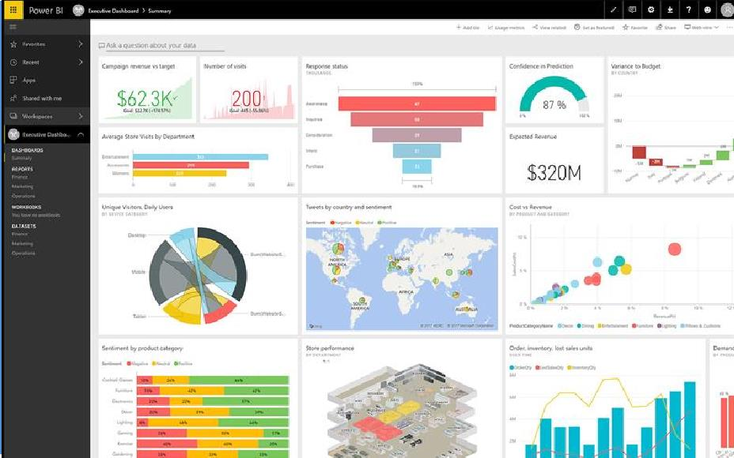


Power BI Service
Advanced integration
Publish reports securely
Easy to access
www.dsa.az Bütün hüquqlar qorunur.
DATA SCIENCE ACADEMY
7

Slide 8

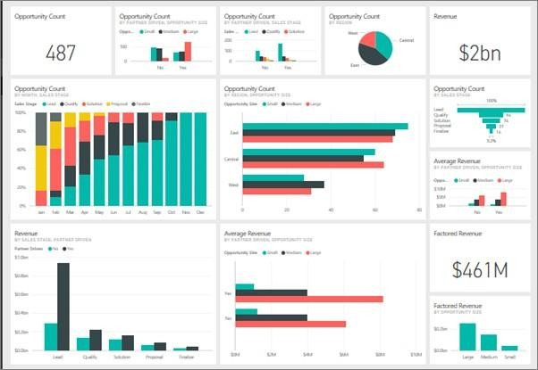




Get Data
www.dsa.az Bütün hüquqlar qorunur.
DATA SCIENCE ACADEMY
8

Slide 9
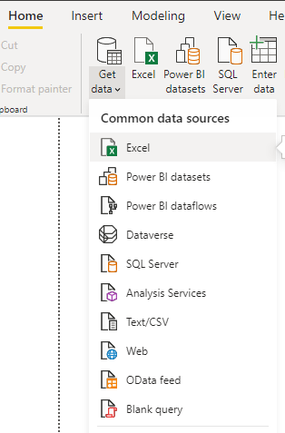
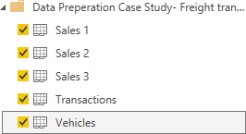
Get Data
Import data from a Microsoft Excel workbook:
Click Get Data Button from Home tab
Select related data format => in our case Excel
Select related data
Select necessary files sheets from Excel file
=> Sales1, Sales2, Sales3, Transactions, Vehicles, Locations
Select Load data
www.dsa.az Bütün hüquqlar qorunur.
DATA SCIENCE ACADEMY
9

Slide 10
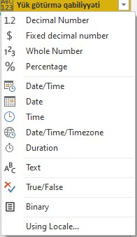
Defining Data Types
Click Transform Data from Home tab.
Click ABC/123 from left upper corner in column named “Yük götürmə qabiliyyəti”.
Select Text from data types.
Transform tab opens new edit query window. With this window, tasks related data can be automatized.
www.dsa.az Bütün hüquqlar qorunur.
DATA SCIENCE ACADEMY
10

Slide 11
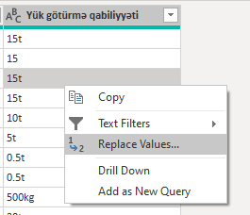
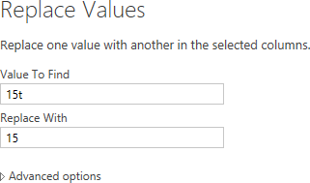
Data cleaning
Right click on any row in the table
Click Replace Values
Write 15t, and 15 in the Value to Find and Replace With areas respectively
Transform all of the rows in “Yük Götürmə qabiliyyəti” properly.
www.dsa.az Bütün hüquqlar qorunur.
DATA SCIENCE ACADEMY
11

Slide 12
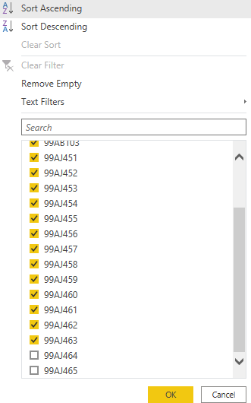
Data filtering and sorting
Click little reversed triangle icon on the header of column named “seriya nömrəsi”
Click “99AJ464” and “99AJ465” series numbers for removing them from the list and click OK.
For Sorting correctly, decide the proper column.
After clicking the same icon, choose Sort Ascending or Descending properly
In the Text Filters part is used for filtering the special characters. For instance, filtering the column ends with “100”
www.dsa.az Bütün hüquqlar qorunur.
DATA SCIENCE ACADEMY
12

Slide 13
II
Data Preparation

Slide 14
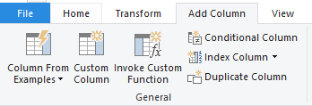
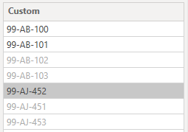
Column From Examples
Let’s convert series number from format “99AB123” to “99-AB-123”
Select Column From Examples from Add Column tab.
Write a few examples in the new created column.
After getting expected result, double click to Header of column and name it properly and click OK.
www.dsa.az Bütün hüquqlar qorunur.
DATA SCIENCE ACADEMY
14

Slide 15
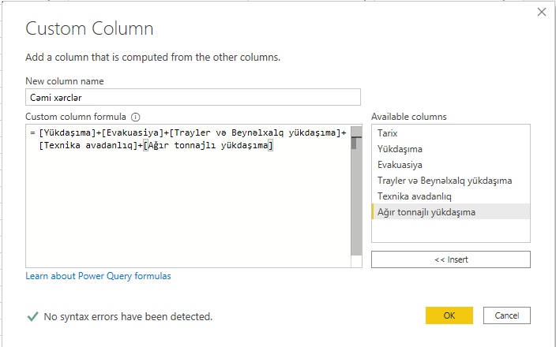
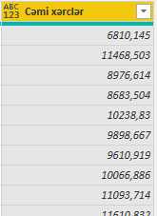
Custom Column
It is used for creating new columns using codes
Select Custom Column from Add Column tab.
Write Column name and “expression formula” in the new column name and formula area respectively.
Click OK.
www.dsa.az Bütün hüquqlar qorunur.
DATA SCIENCE ACADEMY
15

Slide 16
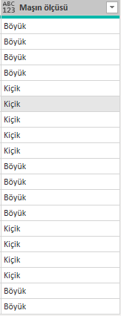
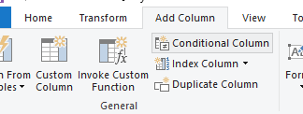
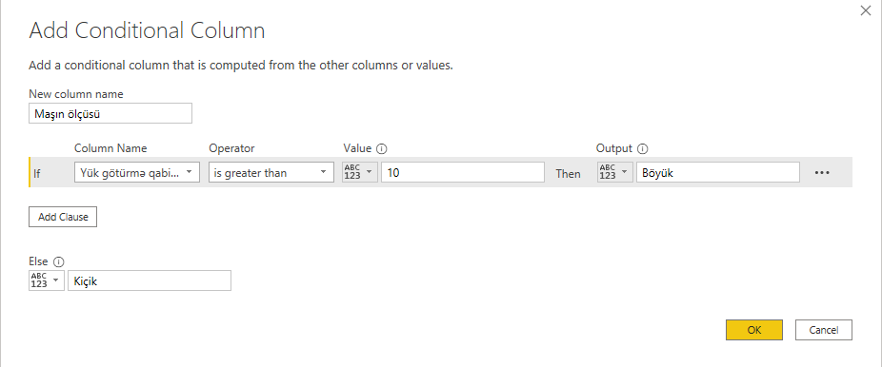
Conditional Column
It is used for creating new columns with certain conditions
Select Conditional Column from Add Column tab.
Write Column name, Conditions and else statement properly.
Click OK.
www.dsa.az Bütün hüquqlar qorunur.
DATA SCIENCE ACADEMY
16

Slide 17
Task 1
Using Column from examples, in Transactions table create 2 new columns from column named “Sürücü və Nəqliyyat vasitəsi”
In the first column write rows like “90-AB-123” and name it as “Serie number”.
In the other column write rows like “M.Əmirov” and name it as “Drivers”
Tips: Since M. Amirov came first in the driver's name column, we will not be able to write any examples other than “M. Əmirov”. To do this, you can first configure the arrangement of driver names by clicking on the filter button to the right of the “Məsafə” (km) column and selecting Sort Ascending.
www.dsa.az Bütün hüquqlar qorunur.
DATA SCIENCE ACADEMY
17

Slide 18
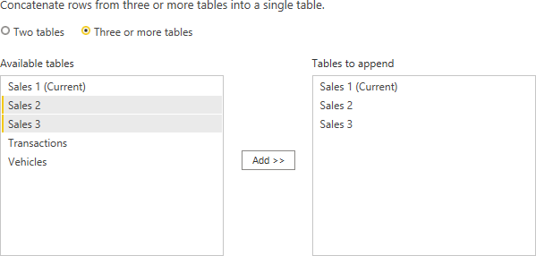
Append Queries
Go to the Sales1 table and select Append queries> Append Queries as new from the Home tab.
Select three or more tables in the new window.
Click Sales2 and add it.
Click Sales3 and add it.
Click OK and append it.
If Append queries as new is not selected, other 2 tables will append to Sales1 table.
www.dsa.az Bütün hüquqlar qorunur.
DATA SCIENCE ACADEMY
18

Slide 19
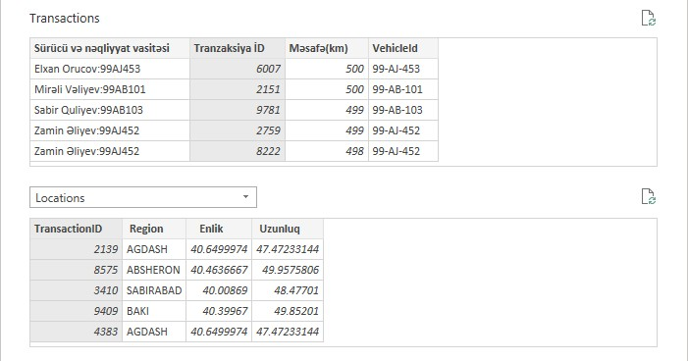
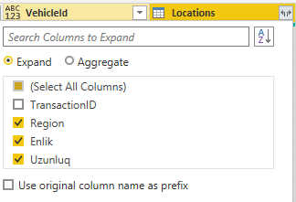
Merge queries
Select Transactions table
Click Merge Queries from the home tab
In the opened window, Select Locations as second table
Select TransactionsID for both of tables.
After clicking OK, click double arrow icon and select proper selections that are shown in the example
www.dsa.az Bütün hüquqlar qorunur.
DATA SCIENCE ACADEMY
20

Slide 20

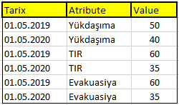
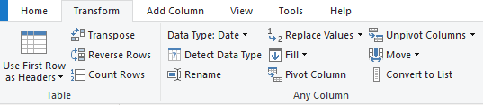

Unpivot
In the Queries section on the left side of the window, double-click Append1 and name it SalesAppended
In the SalesAppended data, select the column named “Tarix” and go to the Transform tab
In the Unpivot Columns drop-down window, select Unpivot Other Columns
We simply change the structure by compacting the Columns with Unpivot
www.dsa.az Bütün hüquqlar qorunur.
DATA SCIENCE ACADEMY
19

Slide 21
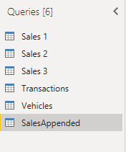
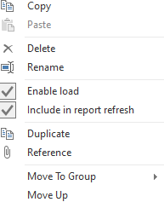
Duplicating tables
Right-click on the SalesAppended query in the Queries section on the left
Select Duplicate
Double click on the SalesAppended(2) table and name it Sales (copy)
Double-click the Attribute column in the table and name it "Service", Value-> "Income" (in the SalesAppend table, name the columns with the same way)
Unlike Duplicate, when you make changes to the SalesAppend table in Reference, the changes are reflected in the Reference query.
www.dsa.az Bütün hüquqlar qorunur.
DATA SCIENCE ACADEMY
21

Slide 22
III
Data Modelling

Slide 23
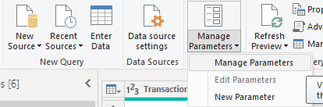
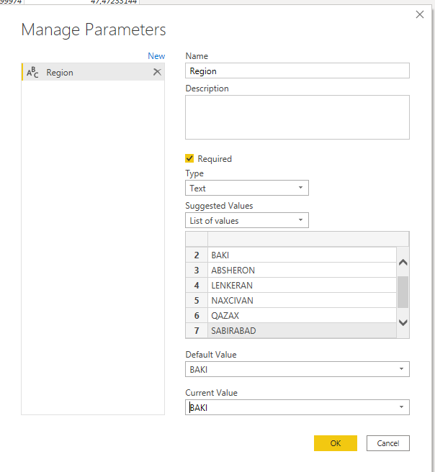
Parameters
Select Manage Parameters Button from Home tab
Write following instruction from the example in the new opened window.
Click OK
www.dsa.az Bütün hüquqlar qorunur.
DATA SCIENCE ACADEMY
23

Slide 24
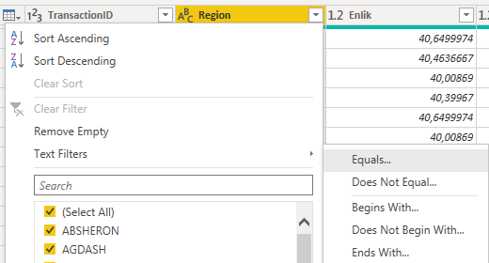
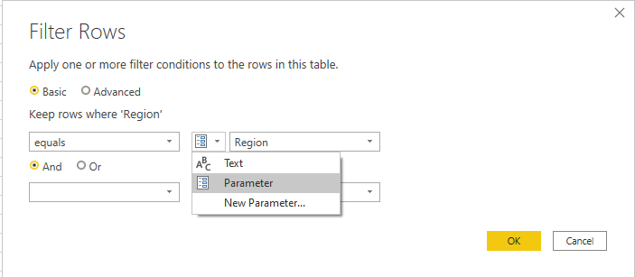
Use Parameters
Click reversed triangle icon in the header of the Region column.
Select Text filters and Equals… tab
Select Parameters button in the new opened window and click OK
www.dsa.az Bütün hüquqlar qorunur.
DATA SCIENCE ACADEMY
24

Slide 25
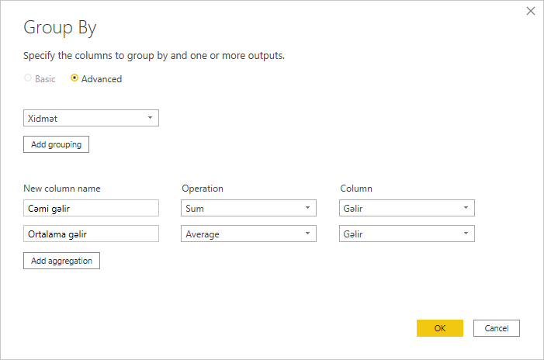
Group by
Select “Service” column from Sales (copy) table
Click Group by button from Transform tab
Select Advanced in new opened window
New column name: Sum of Income,
Operation: Sum,
Column: Income
Then, it can be measured different calculations with clicking Add aggregation. For example, Average Income
www.dsa.az Bütün hüquqlar qorunur.
DATA SCIENCE ACADEMY
25

Slide 26
Relationship
Cardinality type | Cross filter options
One-to-one | Single Both
One-to-many (Many-to-one) | Both
Many-to-many | Single (Table 1 to Table 2) Single (Table 2 to Table 1) Both
Customers
ID-Costumer | FirstName | SecondName
1 | Maximilian | Schwarzmueller
2 | John | Meyer
3 | Linda | Belle
4 | Manuel | Lorenz
ID-Passport | Valid | Issued | FirstName | SecondName | Country
1 | 2025 | 2005 | Maximilian | Schwarzmueller | Germany
2 | 2019 | 1999 | John | Meyer | USA
3 | 2017 | 1997 | Linda | Belle | Japan
Orders
ID-Order | OrderDate | ID-Customer
A | 01 Jan 2017 | 1
B | 08 Jan 2017 | 2
C | 15 Jan 2017 | 1
D | 25 Jan 2017 | 1
E | 05 Feb 2017 | 3
F | 15 Feb 2017 | 4
Passport
Person
ID-Passport | Valid | Issued
1 | 2025 | 2005
2 | 2019 | 1999
3 | 2017 | 1997
ID-Passport | FirstName | SecondName | Country
1 | Maximilian | Schwarzmueller | Germany
2 | John | Meyer | USA
3 | Linda | Belle | Japan
www.dsa.az Bütün hüquqlar qorunur.
DATA SCIENCE ACADEMY
26

Slide 27
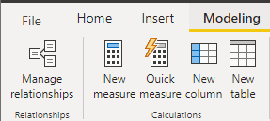
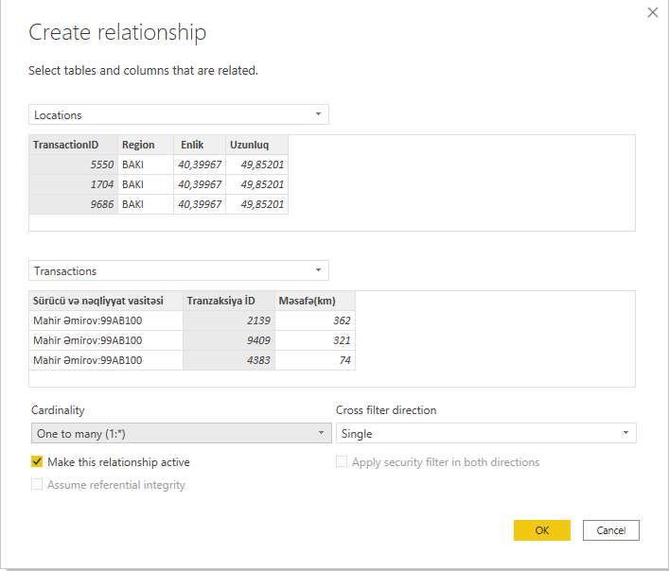
Relationship
Click Manage Relationship button from Modelling tab
Click New button
Select compatible tables and columns.
Select the most compatible cardinality for tables (it is also chose automatically)
Click OK
www.dsa.az Bütün hüquqlar qorunur.
DATA SCIENCE ACADEMY
27

Slide 28
Refresh
Open the Vehicles sheet in the excel file where the data was taken
Add a new vehicle to the data
Seriya nömrəsi: 10BD656
Nəqliyyat vasitəsi uzunluğu: 2m
Yükgötürmə qabiliyyəti: 500kg
Save Excel doc
Click Refresh from Home tab in Power BI
As a result, the new vehicle we added to Excel, as well as “Yük götürmə qabiliyyəti” and “Seriya nömrəsi” of this vehicle will be transformed into Power BI.
www.dsa.az Bütün hüquqlar qorunur.
DATA SCIENCE ACADEMY
28

Slide 29
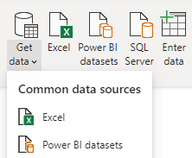
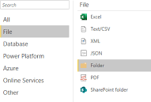
Get data from Folder
We can import and combine several excel documents at the same time
First, copy the link to the folder you want to select
Click Get Data from Home tab
Select More
Select Folder from the file tab
In the Folder Path drop-down section, enter the link you copied
Load Data in the new opened window
www.dsa.az Bütün hüquqlar qorunur.
DATA SCIENCE ACADEMY
29

Slide 30
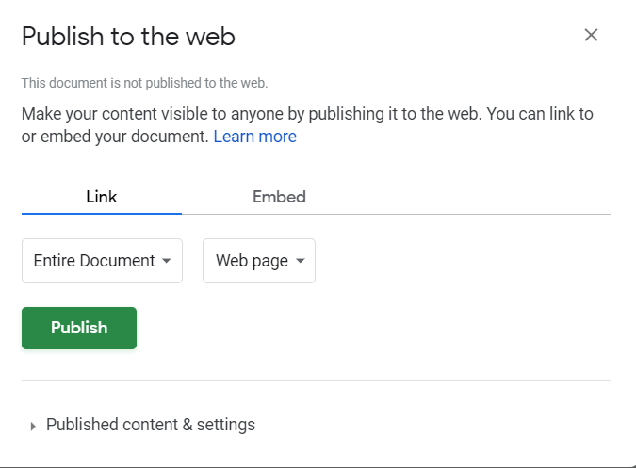
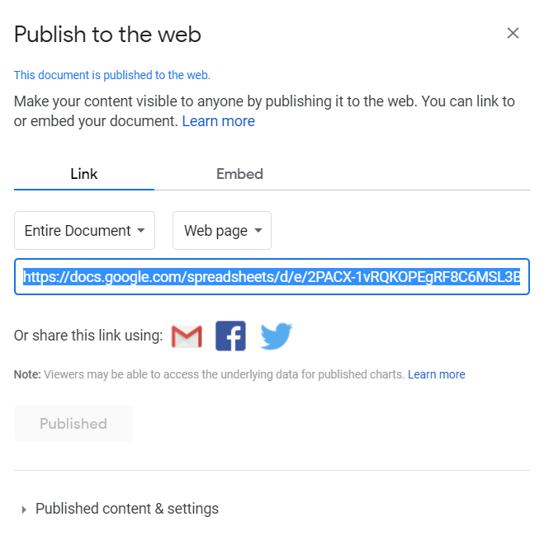
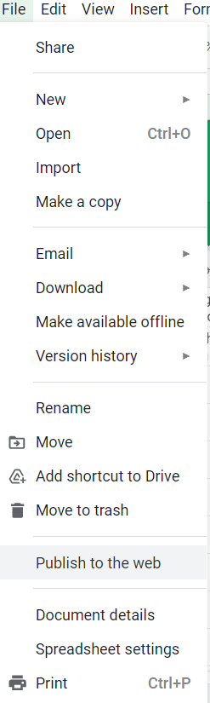
Get updated data from Google Sheet
Select our data in the Google Spreadsheet - from the File tab, select Publish to the Web
Publish it and copy the link from the new opened window
www.dsa.az Bütün hüquqlar qorunur.
DATA SCIENCE ACADEMY
30

Slide 31
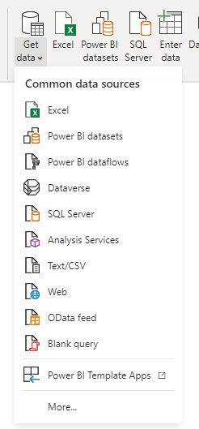
Get updated data from Google Sheet
Click Get data from Home tab
Click Web button from the new drop-down selection
Then paste copied link to the area
www.dsa.az Bütün hüquqlar qorunur.
DATA SCIENCE ACADEMY
31

Slide 32
Web Scrapping
Go to the website where you want to get the data and copy the appropriate URL
In the Get data section, select Web and paste the copied URL
Select connect in the new opened window
Then in the window that opens, select one of the template tables
If there are no complete results in the template tables by selecting Add table using examples
Write examples in Column1
www.dsa.az Bütün hüquqlar qorunur.
DATA SCIENCE ACADEMY
32

Slide 33
Thank you!

